Slide 1
Circle Geometry
Angle Properties of the Circle

Slide 2
Features of a circle
Concept Development
Radius
Diameter
Circumference
Minor Arc
Major Arc
Minor Sector
Major Sector
Chord
Minor Segment
Major Segment
Tangent
Secant

Slide 3


Features of a circle
Concept Development
Radius
Diameter
Circumference
Minor Arc
Major Arc
Minor Sector
Major Sector
Chord
Minor Segment
Major Segment
*Tangent
*Secant
O

Slide 4




Features of a circle
Concept Development
Radius
Diameter
Circumference
Minor Arc
Major Arc
Minor Sector
Major Sector
Chord
Minor Segment
Major Segment
*Tangent
*Secant
O

Slide 5
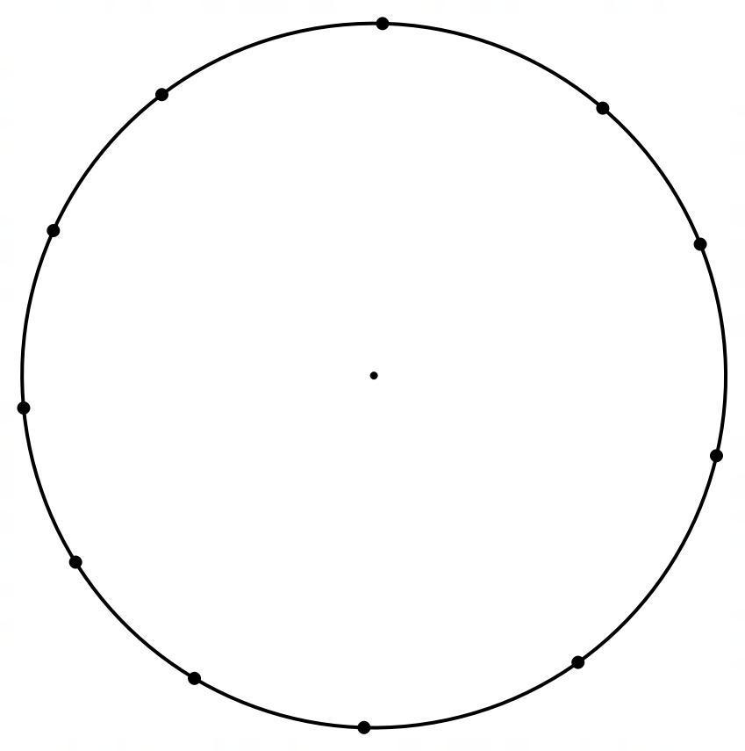
Concept Development – Cyclic Polygons
A set of points is said to be concyclic if they all lie on a common circle.
A polygon is said to be inscribed in a circle if all its vertices lie on the circle.
This implies that no part of the polygon lies outside the circle
A quadrilateral that can be inscribed in a circle is called a cyclic quadrilateral

Slide 6
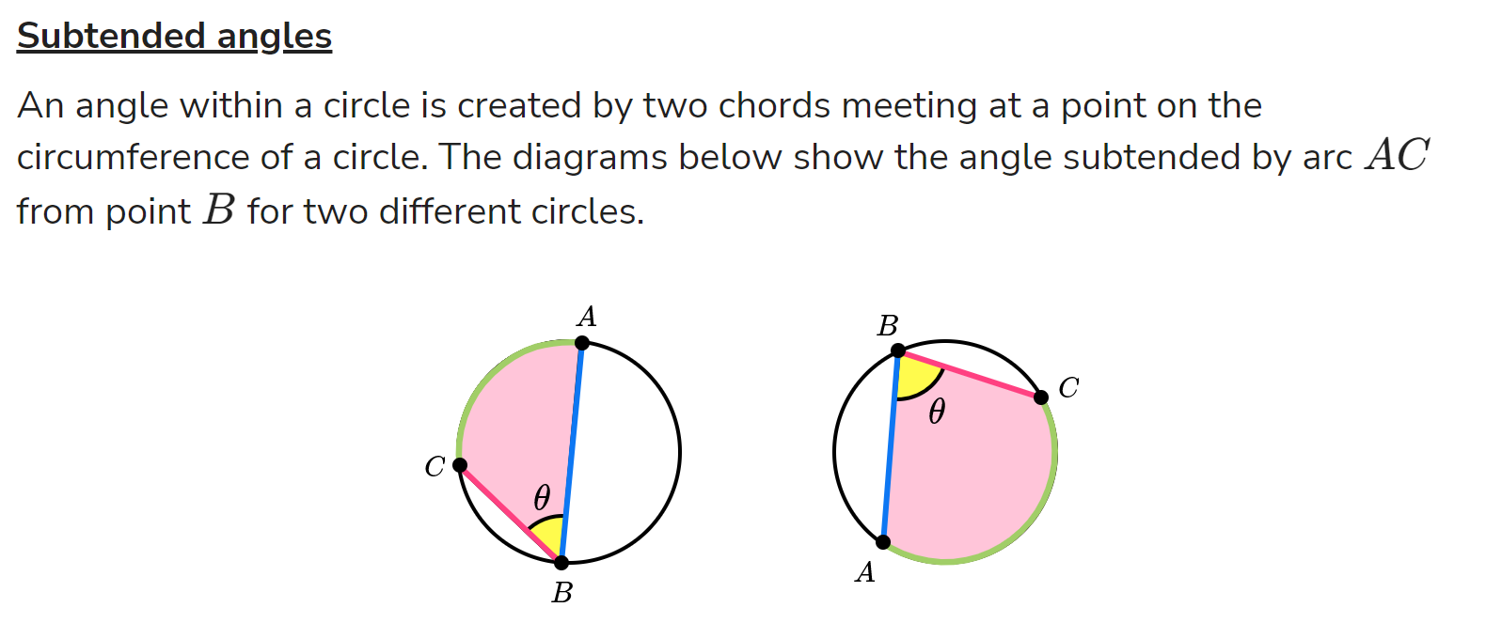
Concept Development

Slide 7
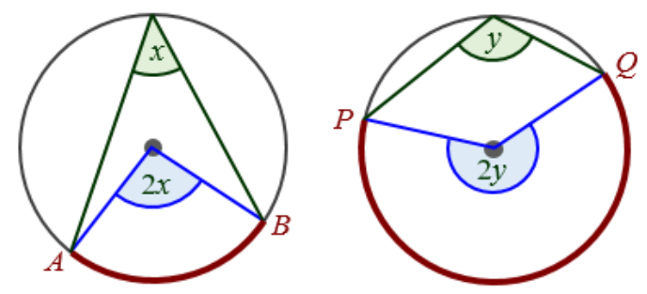
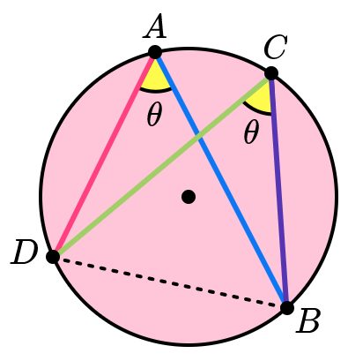
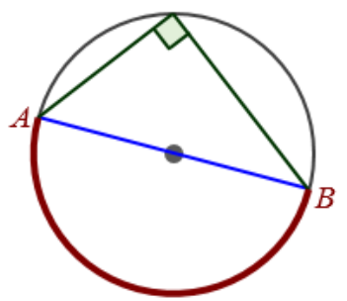
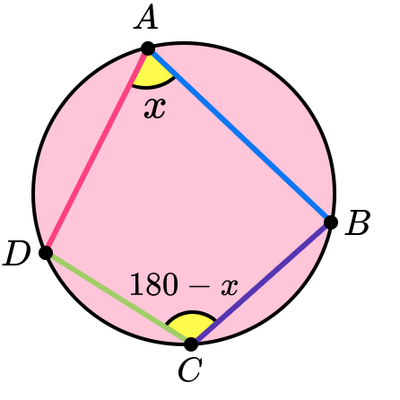
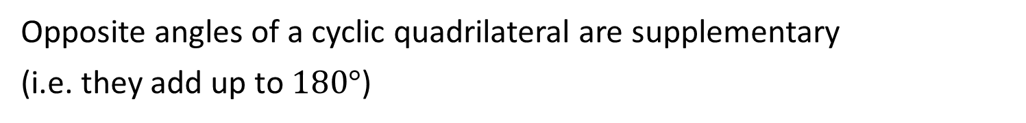
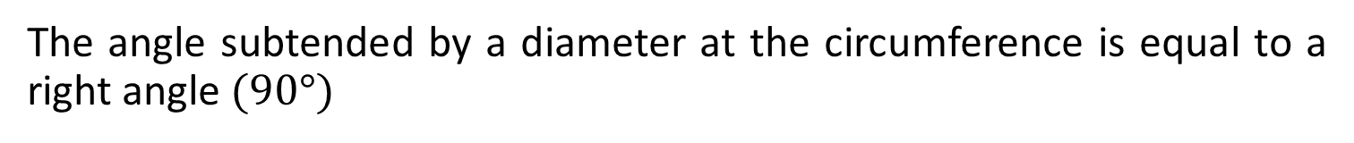
Theorem 1 – Angles in the centre
The angle at the centre of a circle is twice the angle at the circumference subtended by the same arc.
Theorem 2 – Angles in the same segment
Angles in the same segment of a circle are equal
Theorem 3 – Angle in a semicircle is a right angle
The angle subtended by a diameter at the circumference is equal to a right angle $(90°)$
Theorem 4 – Angles of a Cyclic Quadrilateral
Opposite angles of a cyclic quadrilateral are supplementary
(i.e. they add up to $180°$)

Slide 8
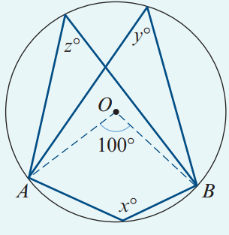


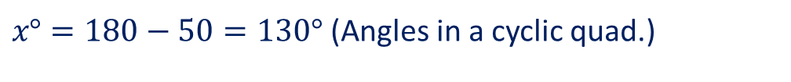

Ex 8A – Example 1
Find the value of each of the pronumerals in the diagram, where O is the centre of the circle and $∠AOB=100°$
$z°=\frac{100}{2}=50°$ (Angles in the centre)
$y°=\frac{100}{2}=50°$(Angles in the centre)
$x°=180−50=130°$ (Angles in a cyclic quad.)

Slide 9
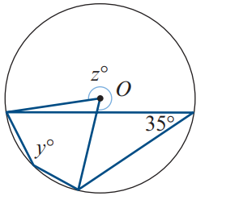
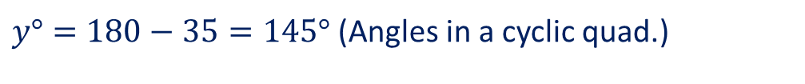
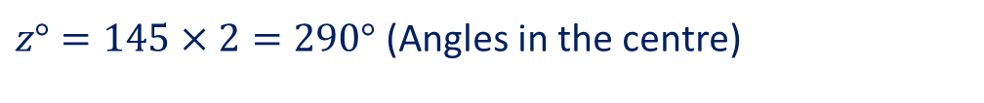


Ex 8A – Q1
Find the value of each of the pronumerals in the diagram, where O is the centre of the circle
$$A$$
$y°=180−35=145°$ (Angles in a cyclic quad.)
$$B$$
$z°=145×2=290°$ (Angles in the centre)

Slide 10
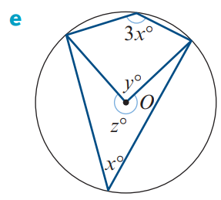
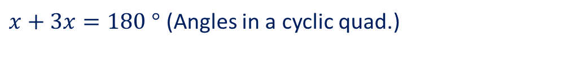
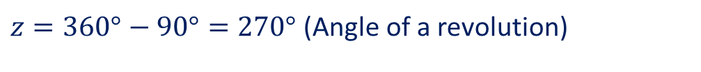
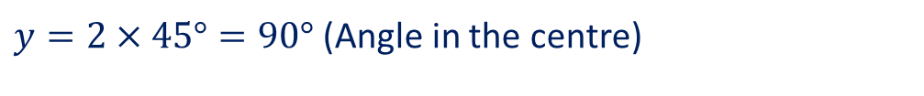
Ex 8A – Q1
Find the value of each of the pronumerals in the diagram, where O is the centre of the circle
$x+3x=180$ $°$ (Angles in a cyclic quad.)
$4x=180°$
$$x=45°$$
$y=2×45°=90°$ (Angle in the centre)
$z=360°−90°=270°$ (Angle of a revolution)

Slide 11
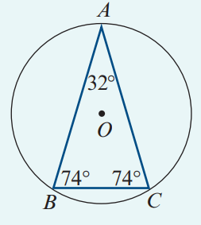



Ex 8A – Example 2
An isosceles triangle is inscribed in a circle as shown.
Find the angles in the 3 minor segments of the circle cut off by the sides of this triangle.

Slide 12
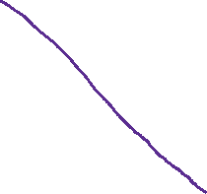







Ex 8A – Q4
$∠DBC=∠DAC=28°$ (Angles in the same segment are equal)
$$B$$
$$∠ABC=98°$$
$∠BAC=∠CDB=20°$ (Angles in the same segment are equal)
$∠DCA=∠ABD=70°$ (Angles in the same segment are equal)
$∠AED=180−70=110°$ (Opp. $∠$ in a cyclic quad. are supp.)
$$A$$
$$C$$
$∠BCD=180−28−20=132°$ (Opp. $∠$ in a cyclic quad. are supp.)
$∠EAD=∠EDA=\frac{180−110}{2}=35°$ (base $∠$ of iso. Triangle)
$$∠EAB=83°$$
$$E$$
$∠BCA=132−70=62°$
$∠ADB=62°$ (Angles in the same segment are equal)
$$D$$
$$∠EDC=117°$$

Slide 13
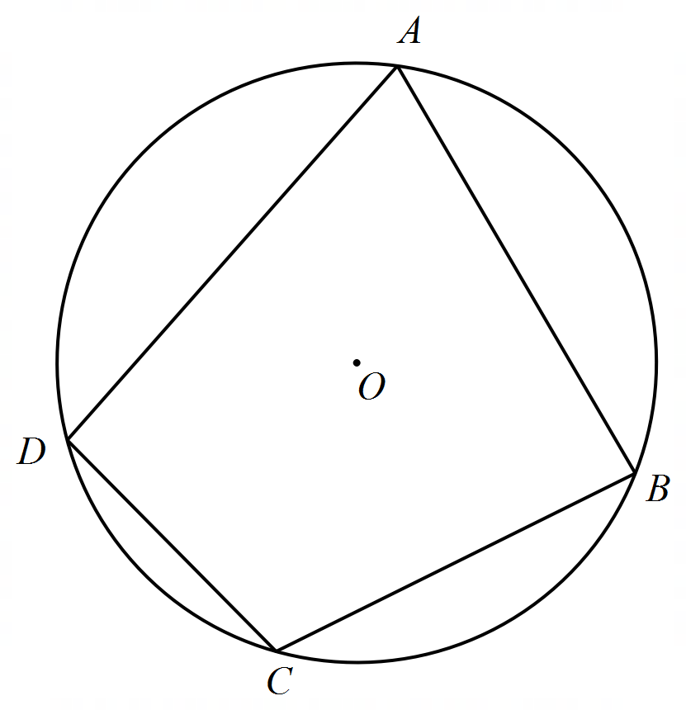




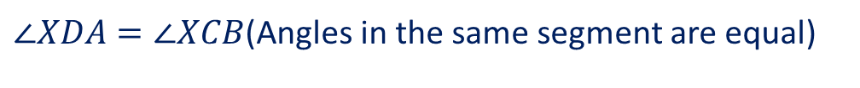
Ex 8A – Example 3
A, B, C and D are points on a circle. The diagonals of quadrilateral ABCD meet at X. Prove that triangles ADX and BCX are similar.
$∠XDA=∠XCB$(Angles in the same segment are equal)
$∠XAD=∠XBC$(Angles in the same segment are equal)
$∠AXD=∠BXC$(vertically opposite angles are equal)
$∆AXD\sim ∆BXC$(AAA) (proved)
$$X$$

Slide 14
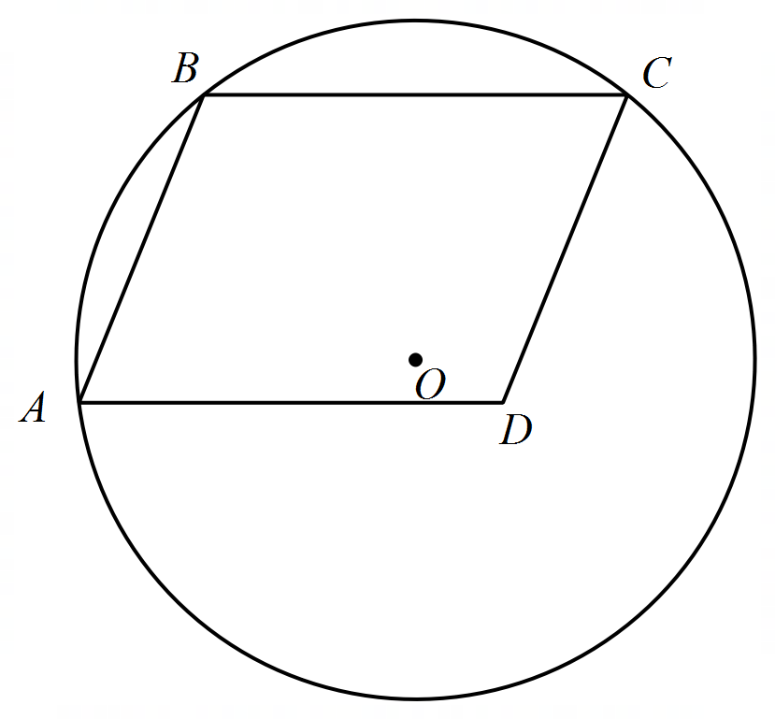



Ex 8A – Q6
$∠ADE+∠ADC=180°$(Supplementary Angles)
$∠AED+∠ABC=180°$ (opposite angles in a cyclic are supplementary)
$∠ADC=∠ABC$ (opposite angles in a parallelogram are equal)
$$∴∠ADE=∠AED$$
$∴AE=AD$ (Opposite sides of equal angles in a triangle are equal)
$$E$$

Slide 15
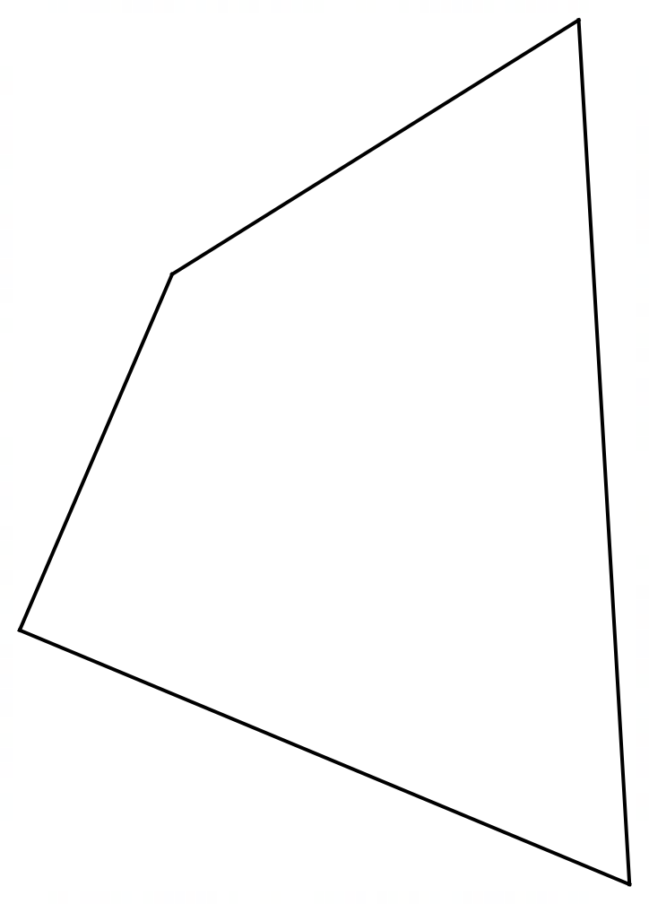








Ex 8A – Q10

Slide 16



Ex 8A – Q10

Slide 17
Independent Practice
Cambridge Ex 8A

